Slide 1
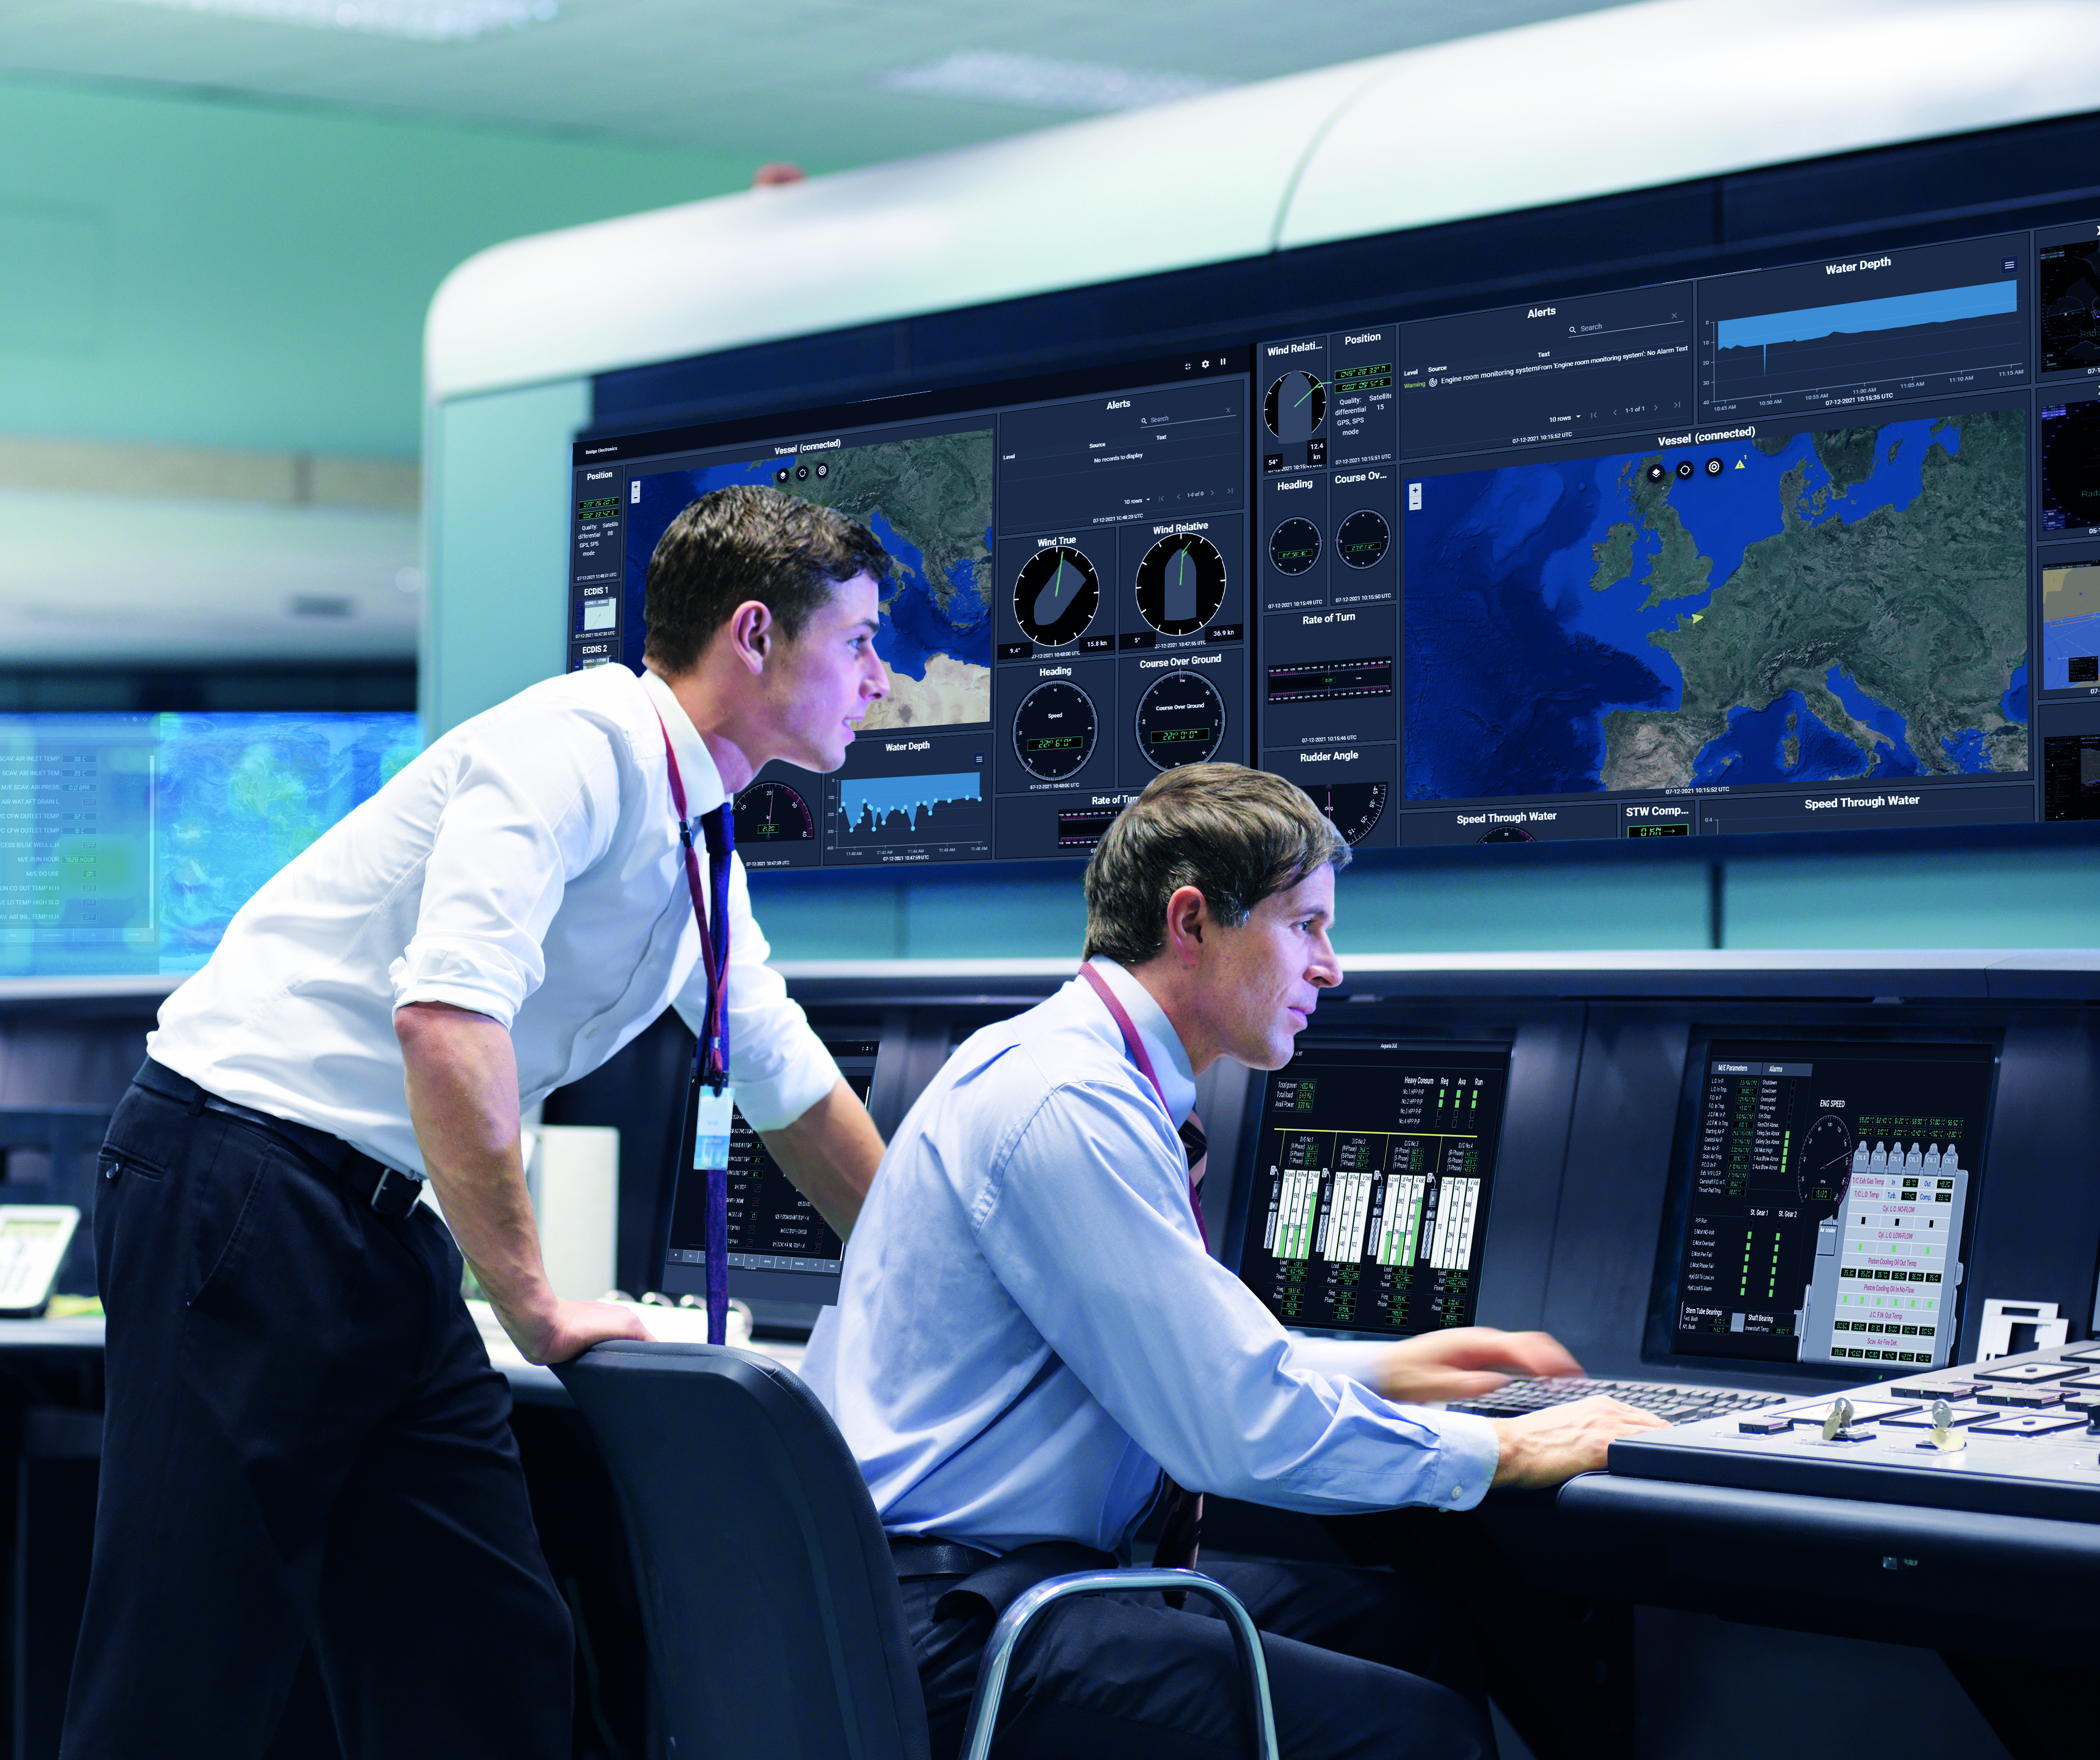
BridgeLink Support workflow
April 2024

Slide 2



TIER 1
TIER 2
RCS
Customer Support (CCCS)
User Management requests
Billing Requests
Billing
Support
Requests
TIER 2
TIER 3
TIER 4
Technical Support (CCTS)
BridgeLink
Technical Support
BridgeLink Development Support
Customer Suppliers & Vendors
Customer Fleet Operation Center
Unitary Connectivity/Collection problems
EDGE bugs
Data Management problems (wrong data, format,…)
FABRIC/GATEWAY bugs
Portal problems
PORTAL bugs
Service & Incident support,
Billing support,
Logistics support
Global Operational problems
Hardware failures
Information & Project Requests
System & Software support
Data Center
Technical Support
Logistics (RMA)
IT/System Support
BridgeLink
Project Team
Procedure and process to resolve EDGE operational problems (BridgeLink equipment reachability and malfunction, vessel systems reachability, good data ingestion, …).
Analysis and troubleshooting to resolve EDGE operational problems implying configuration changes or software updates.
Advanced analysis and troubleshooting to resolve EDGE operational problems implying bug fixes/workaround or software development.
Deployment/activation, Specific software development,
Solution customisation,
Change Request,
Change Management,…
Project
Managmt.
Analysis and troubleshooting to resolve PORTAL problems implying configuration changes or software updates.
Advanced analysis and troubleshooting to resolve PORTAL problems implying bug fixes/workaround or software development.
Customer
Project Team
Analysis and troubleshooting to resolve DATA problems implying configuration changes or software updates.
Advanced analysis and troubleshooting to resolve DATA problems implying bug fixes/workaround or software development.

